Slide 1

Capstone Project-2
Bike Sharing Demand Prediction
Member
Sourabh Pramanik

Slide 2
Contents
Problem Statement
Data Summary
Dependent Variable
Independent Variable
Checking Missing values and Outliers
EDA and Visualization
Test and Train split
Applying Machine Learning models and Hypertuning
Performance of the model after hypertuning
Comparison between models
Final Summary of Conclusion
Q&A

Slide 3
Problem Statement
Here in this project we have one dataset-
SeoulBikeData
Currently the rental bikes are introduced in many urban cities for enhancement of mobility comfort. It is important to make the rental bikes available to public at right time as it lessen the waiting time.
In this project we will try to understand the Bike demand with respect to different timings of the day, months, seasons.

Slide 4
Data Summary
We will complete this project by using following steps-
After reading the data we will perform Exploratory Data analysis.
We will check the Null values and Outliers present in our Dataset.
We will do some statistical analysis of the data.
We will check the distribution of all the numerical columns and correlation between the variables.
After then we will apply different Machine Learning models and will check the performance of the Models by using some performance metrics.

Slide 5
Data Summary
Outcomes of this Project -
Factors which affect the Bike demand.
Selection of appropriate model to predict the demand.
Average count of bikes needed w.r.t every ‘Hour’, ‘Month’, ‘Seasons’.

Slide 6
Independent Variables
Some important Independent variables -
Hours of the day, Temperature, Humidity, Wind Speed, Rainfall, Snowfall, Holiday, Functional Day.

Slide 7
Dependent Variables
Dependent variable-
Rented Bike Count

Slide 8
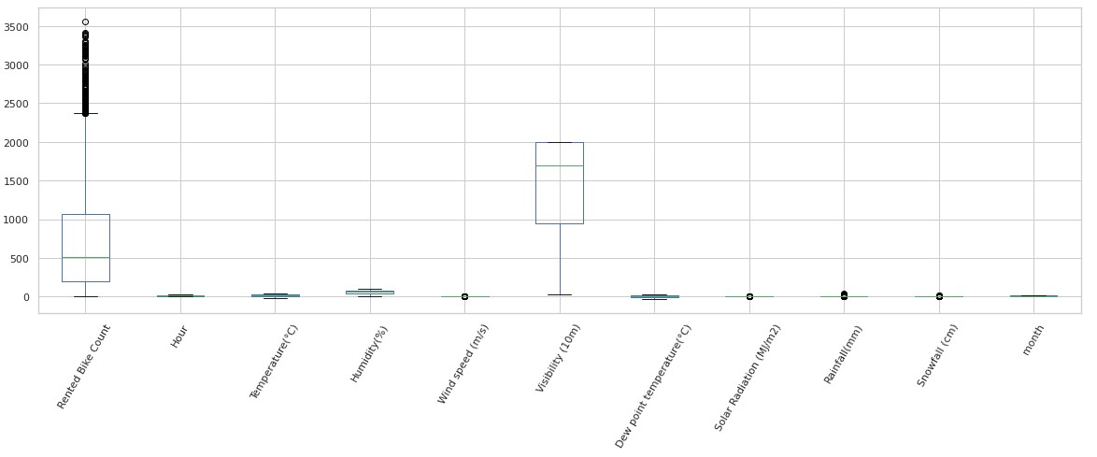
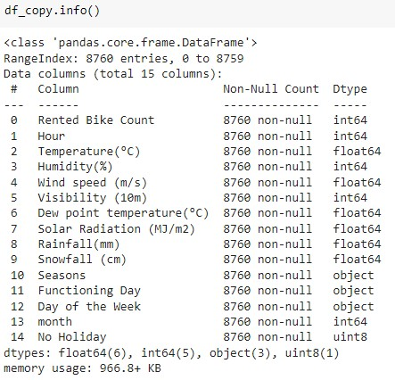
Checking Missing values and Outliers
Outliers
Missing Values

Slide 9
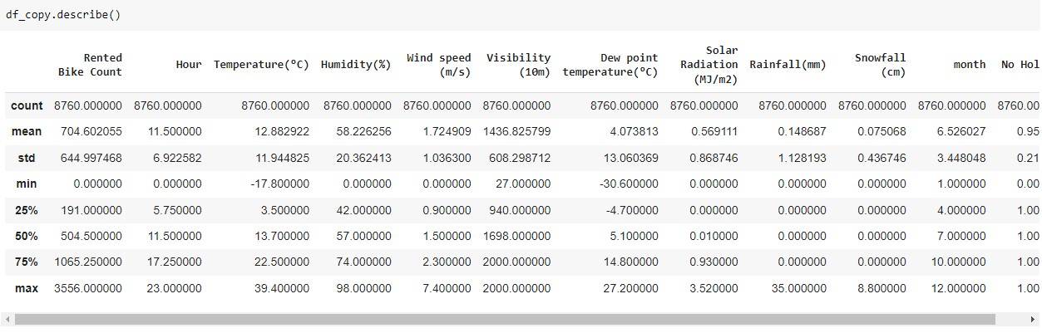
EDA and Visualization
Statistical Distribution

Slide 10
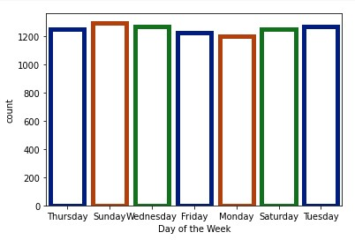
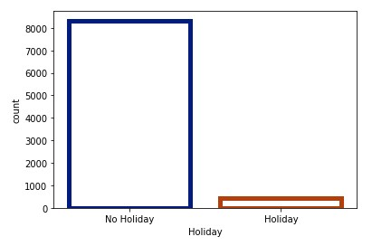
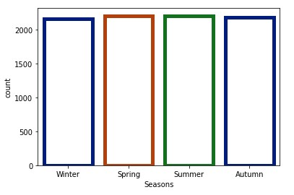
EDA and Visualization
Let’s see the total count of bikes w.r.t ‘Season’, ‘Days of week’, ‘Holidays’ -

Slide 11
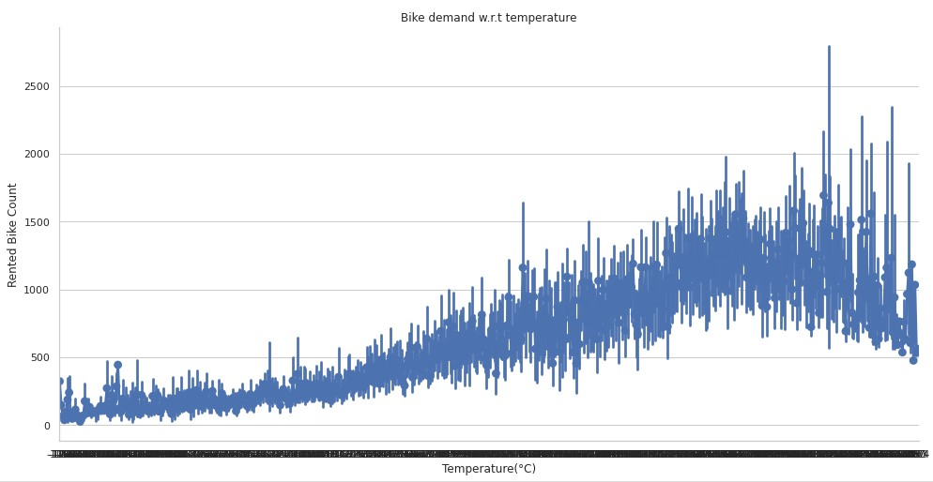
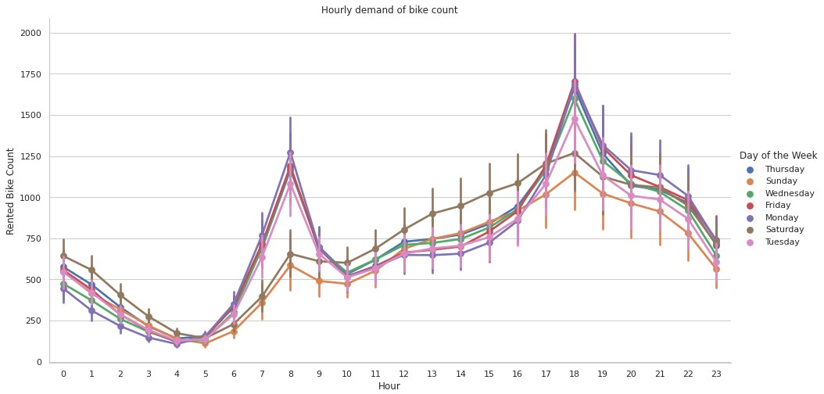
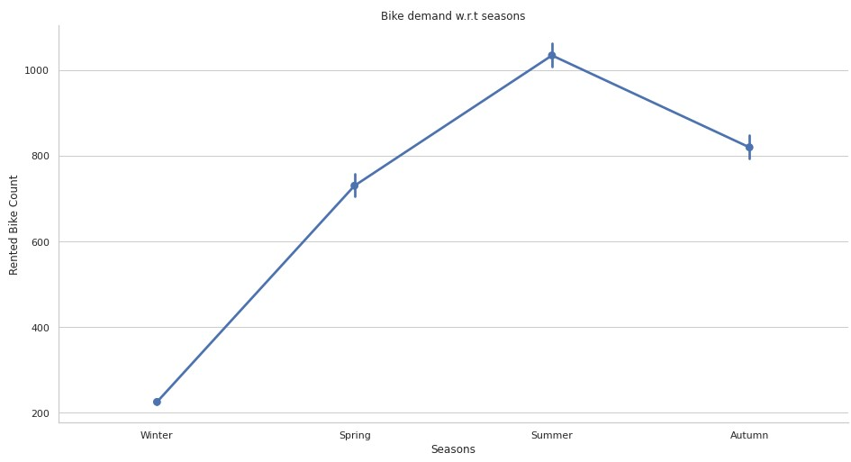
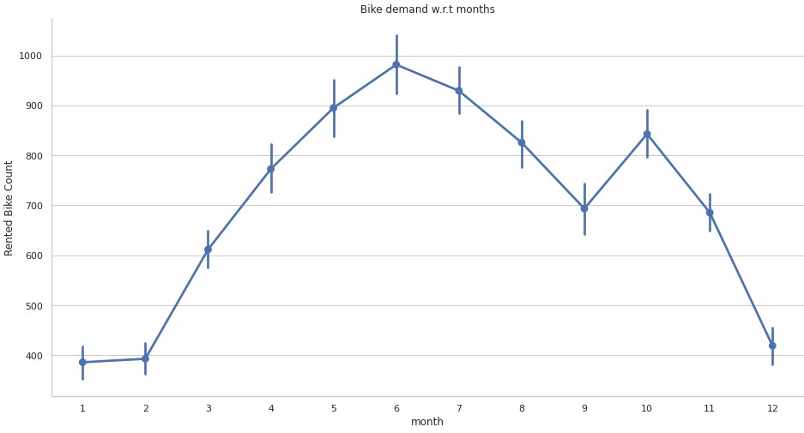
EDA and Visualization
Now we will see the Bike demand w.r.t ‘Every hour in a day’, ‘Month’, ‘Season’,’ Temperature’-

Slide 12
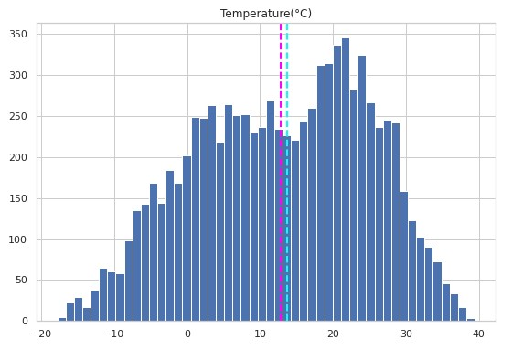
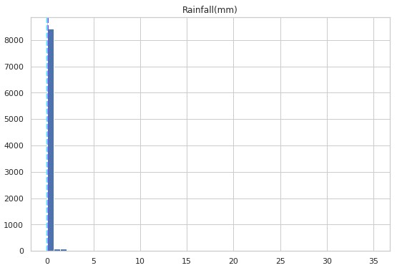
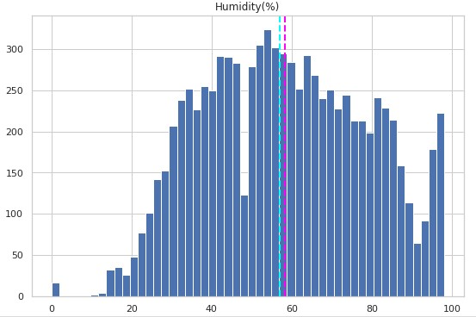
EDA and Visualization
Let’s Visualize the distribution of some of the variables
As we can see here that some of the distribution are not normally distributed so we have applied some Log transformation here.

Slide 13
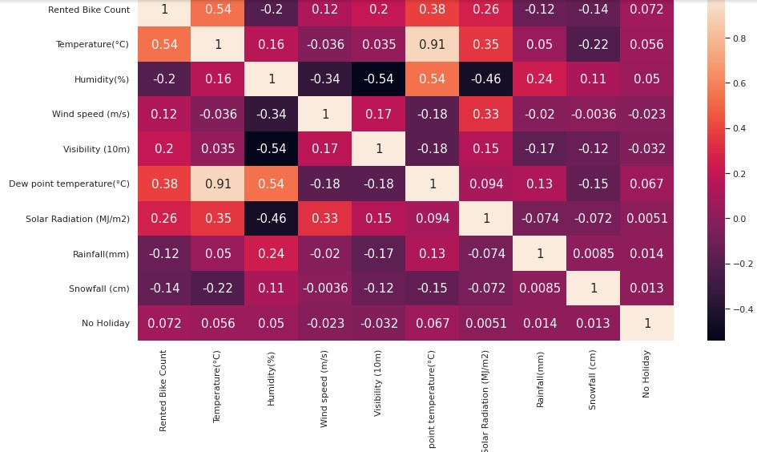
EDA and Visualization

Slide 14


Test and Train Split
Scaling

Slide 15
Applying Machine Learning Models and Hypertuning
Linear Regression
Lasso regression
Decision Tree
Random Forest
XGBoost Algorithm
We will Hypertune our Models by using GridSearchCV.
Here we will use five different models to check the performance-
Logistic regression
Random Forest
XGBoost
KNN
SVM

Slide 16



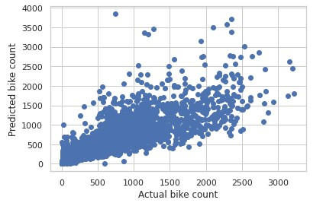
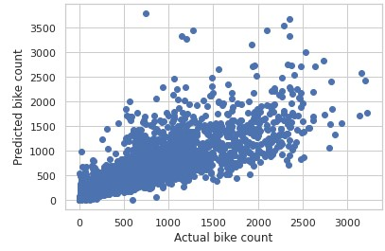
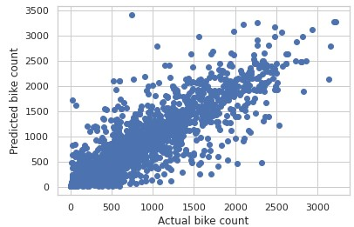
Performance of the Models after hypertuning
Linear Regression
Lasso Regression
Decision Tree

Slide 17


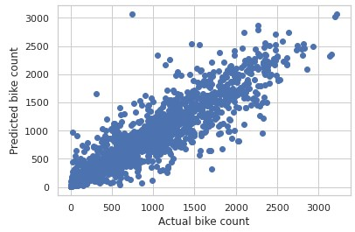
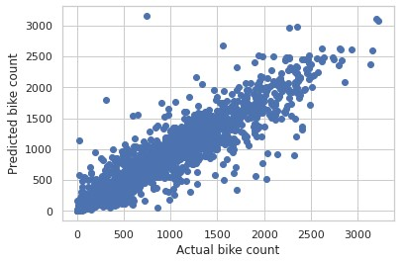
Performance of the Models after hypertuning
Random Forest
XGBoost

Slide 18
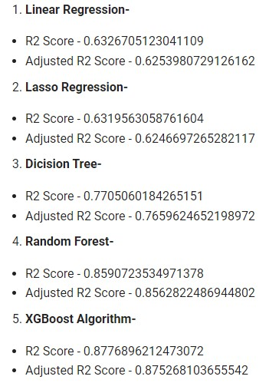
Comparison

Slide 19
Exploration Conclusion
There are 2 rental patterns for Working days and Non-working days.
People generally prefer bikes at moderate to high temperature.
Demand of rental bikes is high between February to October.
Bike demand is high on clear day and lowest on Rainy or Snowy day.
After all the machine learning operation we are coming to the conclusion that Random Forest , XGBoost model performing well than the other models. So in future if we want to do the prediction we can use these models.

Slide 20
Challenges
Elimination of features.
Finding best parameters for the model.

Slide 21
References
https://www.analyticsvidhya.com/
https://towardsdatascience.com/
https://stackoverflow.com/

Slide 22
Q & A

